Slide 1

Bank Analysis
(P626)
- Anamika Shelar

Slide 2
Agenda
01
02
03
04
Introduction
Problem statement
INTRODUCTION & PROCESS
Basic introduction and the process done in project
Basic objective of project
KPI’S & Dashboard
Conclusion
Some Important KPI’S
We will See the Conclusion from Overall Project

Slide 3

Introduction
The Bank Loan Customer Analysis project focuses on understanding key factors influencing loan approvals, repayments, and defaults. By analyzing customer demographics, credit scores, and loan types, the project aims to identify patterns that improve loan decision-making and risk management. This analysis will help optimize the bank's credit policies, reduce default rates, and enhance overall portfolio performance.

Slide 4
Objective
Objective –
To analyze banking data and provide insights for decision-making.
Tools Used-
Power BI, Tableau, Excel, and SQL for data extraction, transformation, and visualization.

Slide 5
Problem statement
The main objective of a Bank Loan Customer Analysis project is to leverage data analysis to assess customer creditworthiness and identify factors influencing loan approvals, repayments, and defaults. This aims to enhance decision-making, optimize the underwriting process, and minimize financial risks for the bank.

Slide 6
Project Overview
Key Questions:
What are the critical factors impacting banking performance?
How can customer behavior be analyzed to improve services?
What patterns in transactions can help improve profitability?
Data Sources: Banking transaction records, customer data, and SQL databases.

Slide 7

Data Collection & Preparation
SQL:
Connected to the SQL database for extracting raw data on customer accounts, transactions, and demographics.
Data Cleaning:
Removed duplicates, handled missing values, and ensured consistency across datasets.
Feature Engineering:
Created additional fields like customer lifetime value, transaction frequencies, and segmentations.

Slide 8

Data Exploration
Initial Findings:
Overview of data trends, distribution of account types, and customer demographics.
Key Metrics:
Average balance, transaction volume, customer retention rates.
Tools Used:
Excel for preliminary exploration and statistics, Power Bi, Tableau.

Slide 9
KPI’S
Year wise loan amount Status
Grade and sub grade wise revol_balance
Verified Status Vs Non Verified Status
State wise and month wise loan status
Home ownership Vs last payment date stats

Slide 10
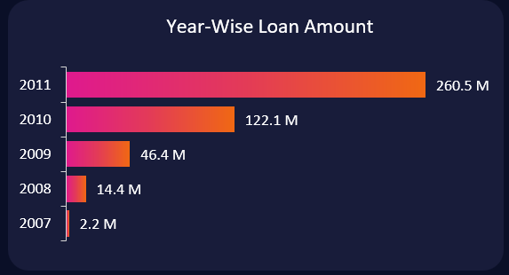
Year wise loan amount Status
Insights:
This KPI tracks how the loan amounts disbursed by the bank vary from year to year. It provides insights into growth trends, economic cycles, or external factors affecting loan demand.
Recommendation:
Analyze the yearly loan stats to identify key drivers behind changes, such as new product launches, interest rate changes, or shifts in consumer demand. Present year-on-year growth rates or trends with visual elements like line or bar charts to highlight significant fluctuations.

Slide 11
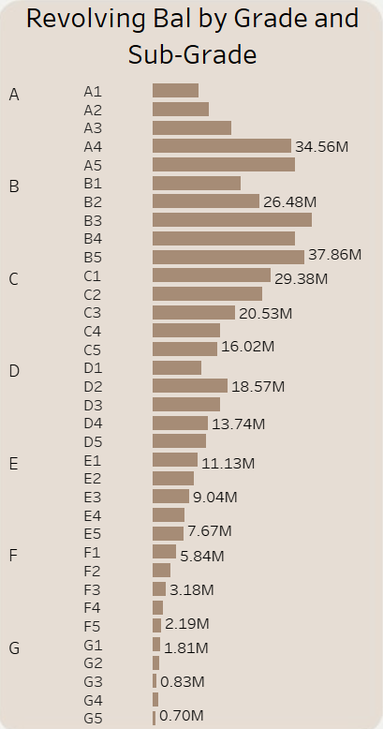
Grade and sub grade wise revol_balance
Insights:
The revolving balance (revol_bal) is the outstanding amount on credit lines such as credit cards. Segmenting this by loan grade (credit score) and subgrade (riskier or safer within the main grade) shows how much debt is being carried by customers in each risk category.
Recommendation: Focus on riskier grades and subgrades with high revolving balances. Consider actions such as tightening credit limits, revising loan terms, or enhancing risk models to manage credit risk.

Slide 12
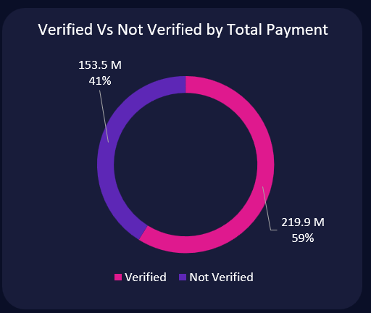
Verified Status Vs Non Verified Status
Insights:
This KPI compares the total payments made by customers whose financial details (e.g., income, employment) were verified at the time of loan issuance versus those whose details were not verified.
Recommendation:
If payments are significantly lower for non-verified customers, consider tightening verification criteria to mitigate risk. Present this data in a comparative bar or pie chart to show the proportion of total payments made by each group.

Slide 13
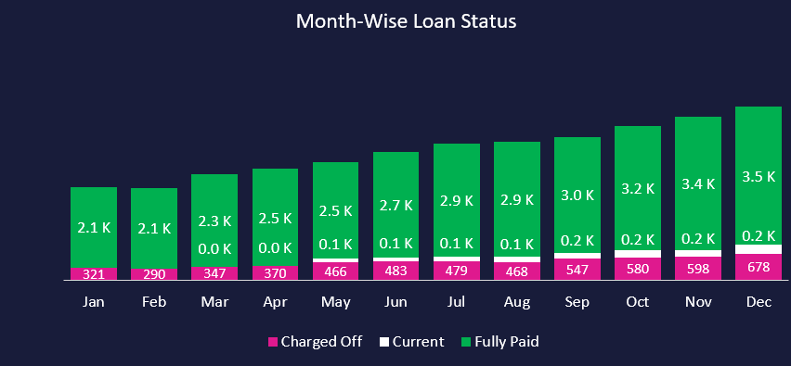
State wise and month wise loan status
Insights:
This KPI looks at the distribution of loans across different states and their statuses (e.g., current, delinquent, fully paid) on a monthly basis. This can show regional variations in loan performance as well as seasonal trends.
Recommendation:
Investigate states or periods with high delinquency or default rates and analyze any external factors contributing to these trends (e.g., local economic conditions). Use heatmaps or stacked bar charts to represent loan status distributions across states and months.

Slide 14
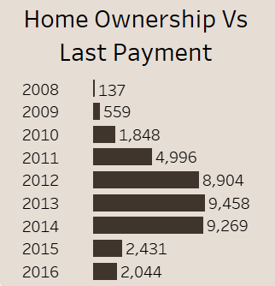
Home ownership Vs last payment date status
Insights:
This KPI examines the relationship between homeownership status (e.g., own, rent, mortgage) and the timing of the last payment made by the customer. It helps to understand how homeownership affects repayment behaviour.
Recommendation:
If homeowners are making timely payments, this could indicate they are lower risk, suggesting potential for favourable loan terms. Conversely, delayed payments from renters or those with mortgages may signal higher risk, prompting the need for more stringent lending criteria or closer monitoring. Present this data in a grouped bar chart, showing payment timing by homeownership status.

Slide 15
MS Excel Dashboard

Slide 16

Excel Analysis
Detailed Analysis:
Performed pivot table analysis for deeper breakdowns of customer data.
Calculated KPIs: profit margins, loan-to-deposit ratio, and revenue growth.
Key Findings:
Specific products and services with higher profit margins.
Customer cohorts that offer long-term growth potential.

Slide 17
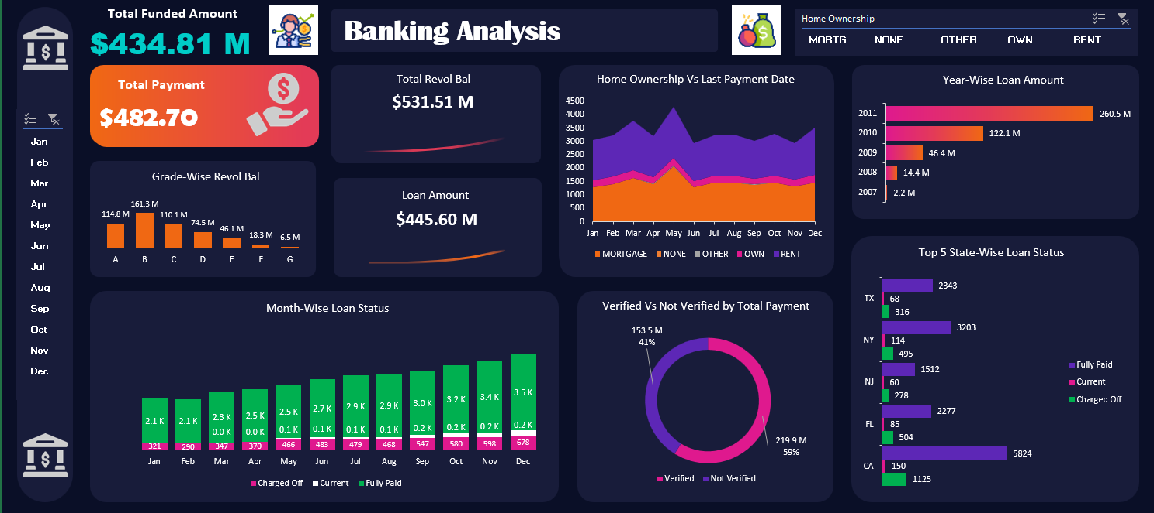

Slide 18
POWER BI DASHBOARD

Slide 19

Power BI Dashboard
Visualizations:
Interactive charts and graphs depicting:
Monthly transaction trends.
Customer segmentation.
Branch performance across regions.
Key Insights:
Identified trends in high-performing branches.
Gaps in customer service for certain demographics.

Slide 20
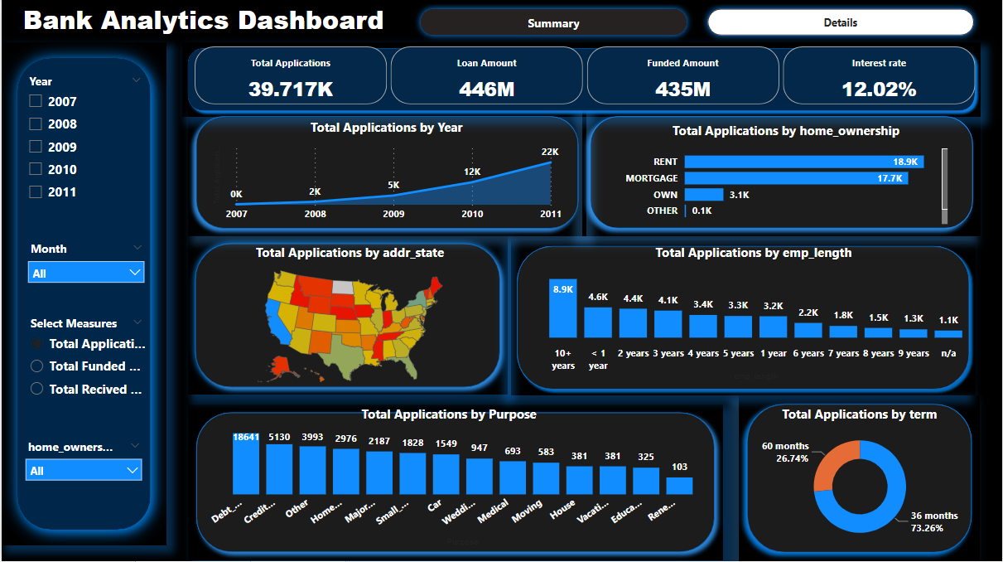

Slide 21
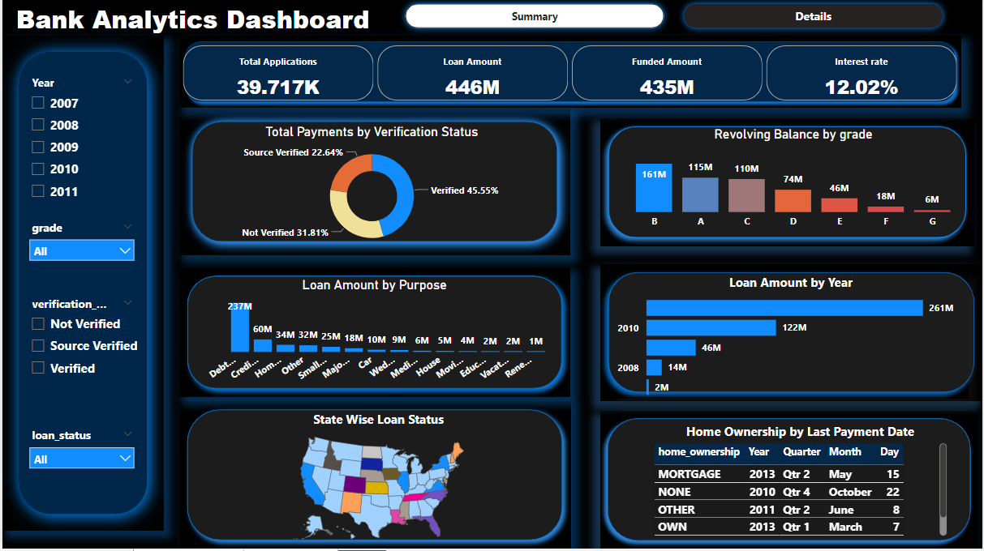

Slide 22
TABLEAU DASHBOARD

Slide 23

Tableau Dashboards
Advanced Visualizations:
Customer journey flow.
Heatmaps of transaction volumes across regions.
Predictive analysis for future customer behavior.
Insight:
High transaction volumes linked to specific customer types and regions.
Early signs of potential customer churn in certain areas.

Slide 24
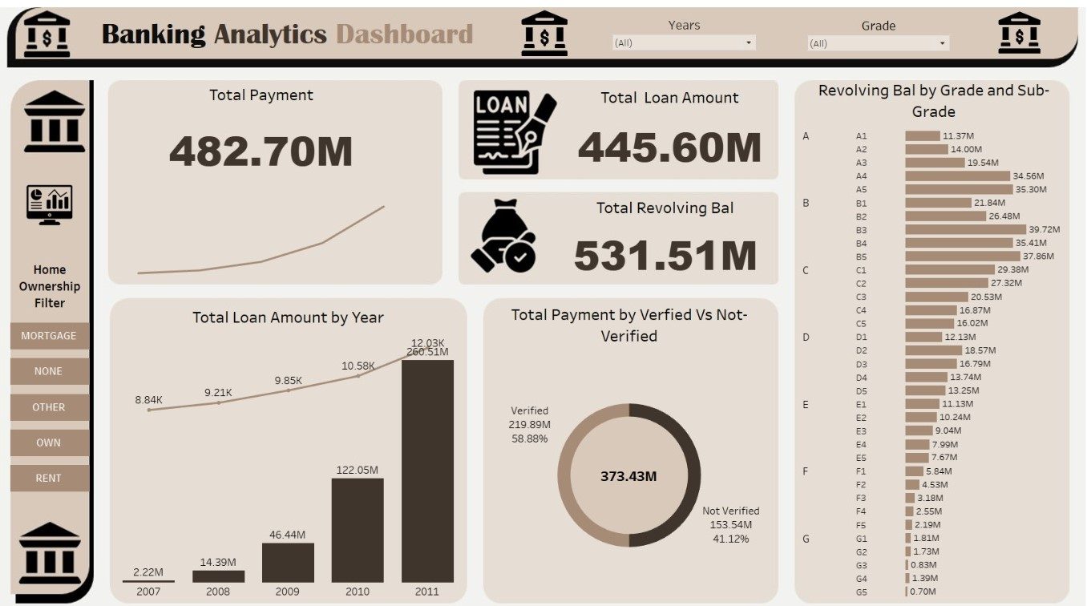

Slide 25
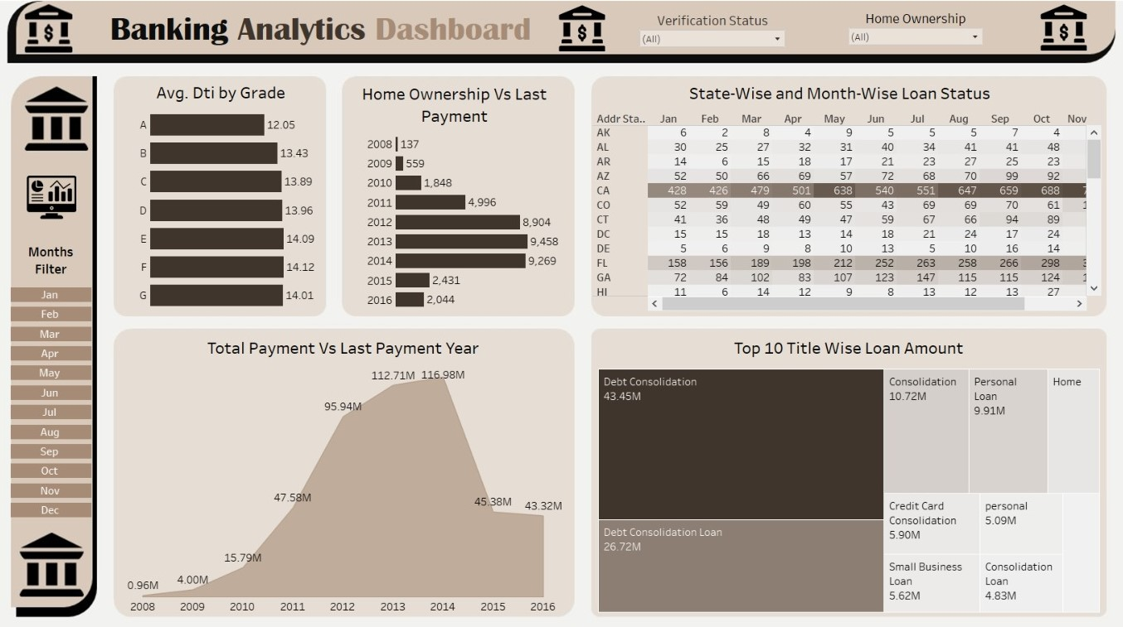

Slide 26
SQL QUERIES

Slide 27
SQL Queries
Data Extraction:
Key SQL queries used to gather data related to:
Customer demographics.
Loan and deposit summaries.
Transactional histories.
Optimization:
Improved query efficiency to enhance data retrieval speed.

Slide 28
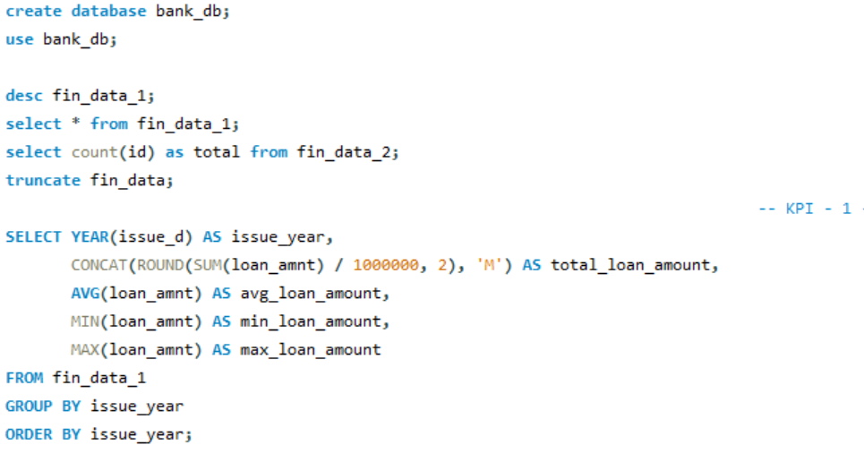

Slide 29
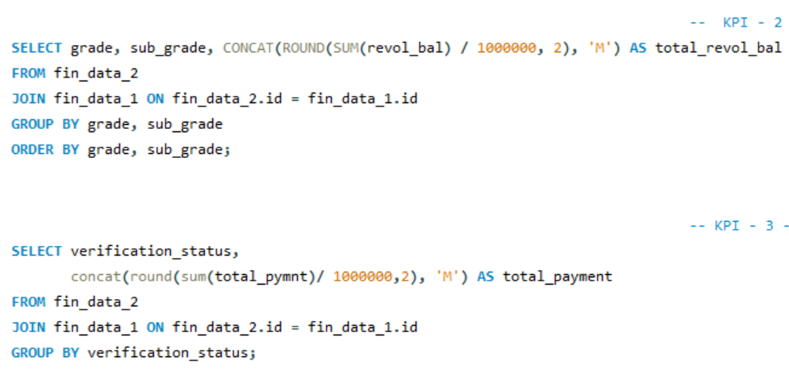

Slide 30
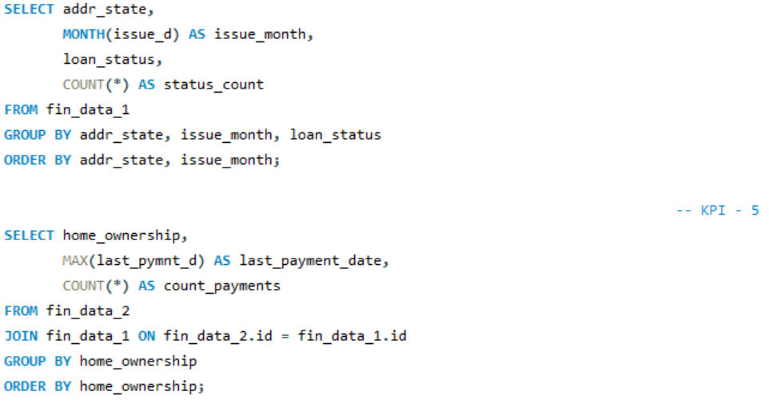

Slide 31
Insights and Recommendations
Customer Behavior:
Identified high-value customers with cross-selling potential.
Recommended targeting specific customer segments for retention strategies.
Branch Optimization:
Recommendations for resource allocation based on performance analysis.
Future Predictions:
Using trends to predict customer churn and product demand.

Slide 32
Challenges & Solutions
Challenges:
Managing large datasets from SQL.
Combining data across tools.
Solutions:
Efficient SQL queries and data cleaning processes.
Using Power BI and Tableau for better data visualization and understanding.

Slide 33
KEY-TAKE AWAY POINTS

Slide 34
1. Customer Segmentation: Identified key customer segments based on demographics, credit scores, and loan behaviours, enabling targeted lending strategies.
2. Risk Identification: Recognized high-risk factors contributing to loan defaults, allowing the bank to refine risk management and underwriting processes.
3. Improved Decision-Making: Provided data-driven insights for more accurate loan approval and rejection decisions, reducing default rates.
4. Predictive Modelling: Developed models to forecast potential loan defaults, helping the bank mitigate financial risks.
5. Enhanced Portfolio Performance: Optimized the overall loan portfolio by improving approval rates for creditworthy customers and reducing losses from risky loans.
6. Data-Driven Policy Adjustments: Offered recommendations for adjusting loan policies to better align with customer risk profiles and market conditions.

Slide 35
CONCLUSION

Slide 36
The Bank Loan Customer Analysis project successfully identified key factors influencing loan approvals and defaults, providing actionable insights for better risk management.
By analyzing customer demographics, credit scores, and loan performance, the project enabled the bank to improve its underwriting process, reduce default rates, and enhance overall portfolio performance.
These data-driven insights will help the bank make more informed lending decisions, tailor products to customer needs, and mitigate financial risks in the future.

Slide 37

— Bob Hope
“A bank is a place that will lend you money if you can prove that you don't need it."

Slide 38

Thank You!
Thank you for your time and attention.

